Slide 1
Final Group Project
Aiza, Julie, Keerthi, Rachel
LMC 3314 | Fall 2019
Notes:
first you will present your project in a powerpoint presentation to the class; this will clarify: who does what on the project? What is the project about? What is its name? How will it look and feel and work?

Slide 2
Interactive Puppet Performance
Controlling the life and choices of an influencer
Recent trend of Instagram Followers Control My Day
Follow the decisions and storyline of a Disney princess
https://www.google.com/search?q=instagram+controls+my+life&rlz=1C1CHBF_enUS728US728&oq=instagram+contr&aqs=chrome.5.69i57j0l6.7464j1j7&sourceid=chrome&ie=UTF-8
Notes:
What is the project about? What is its name? How will it look and feel and work?

Slide 3
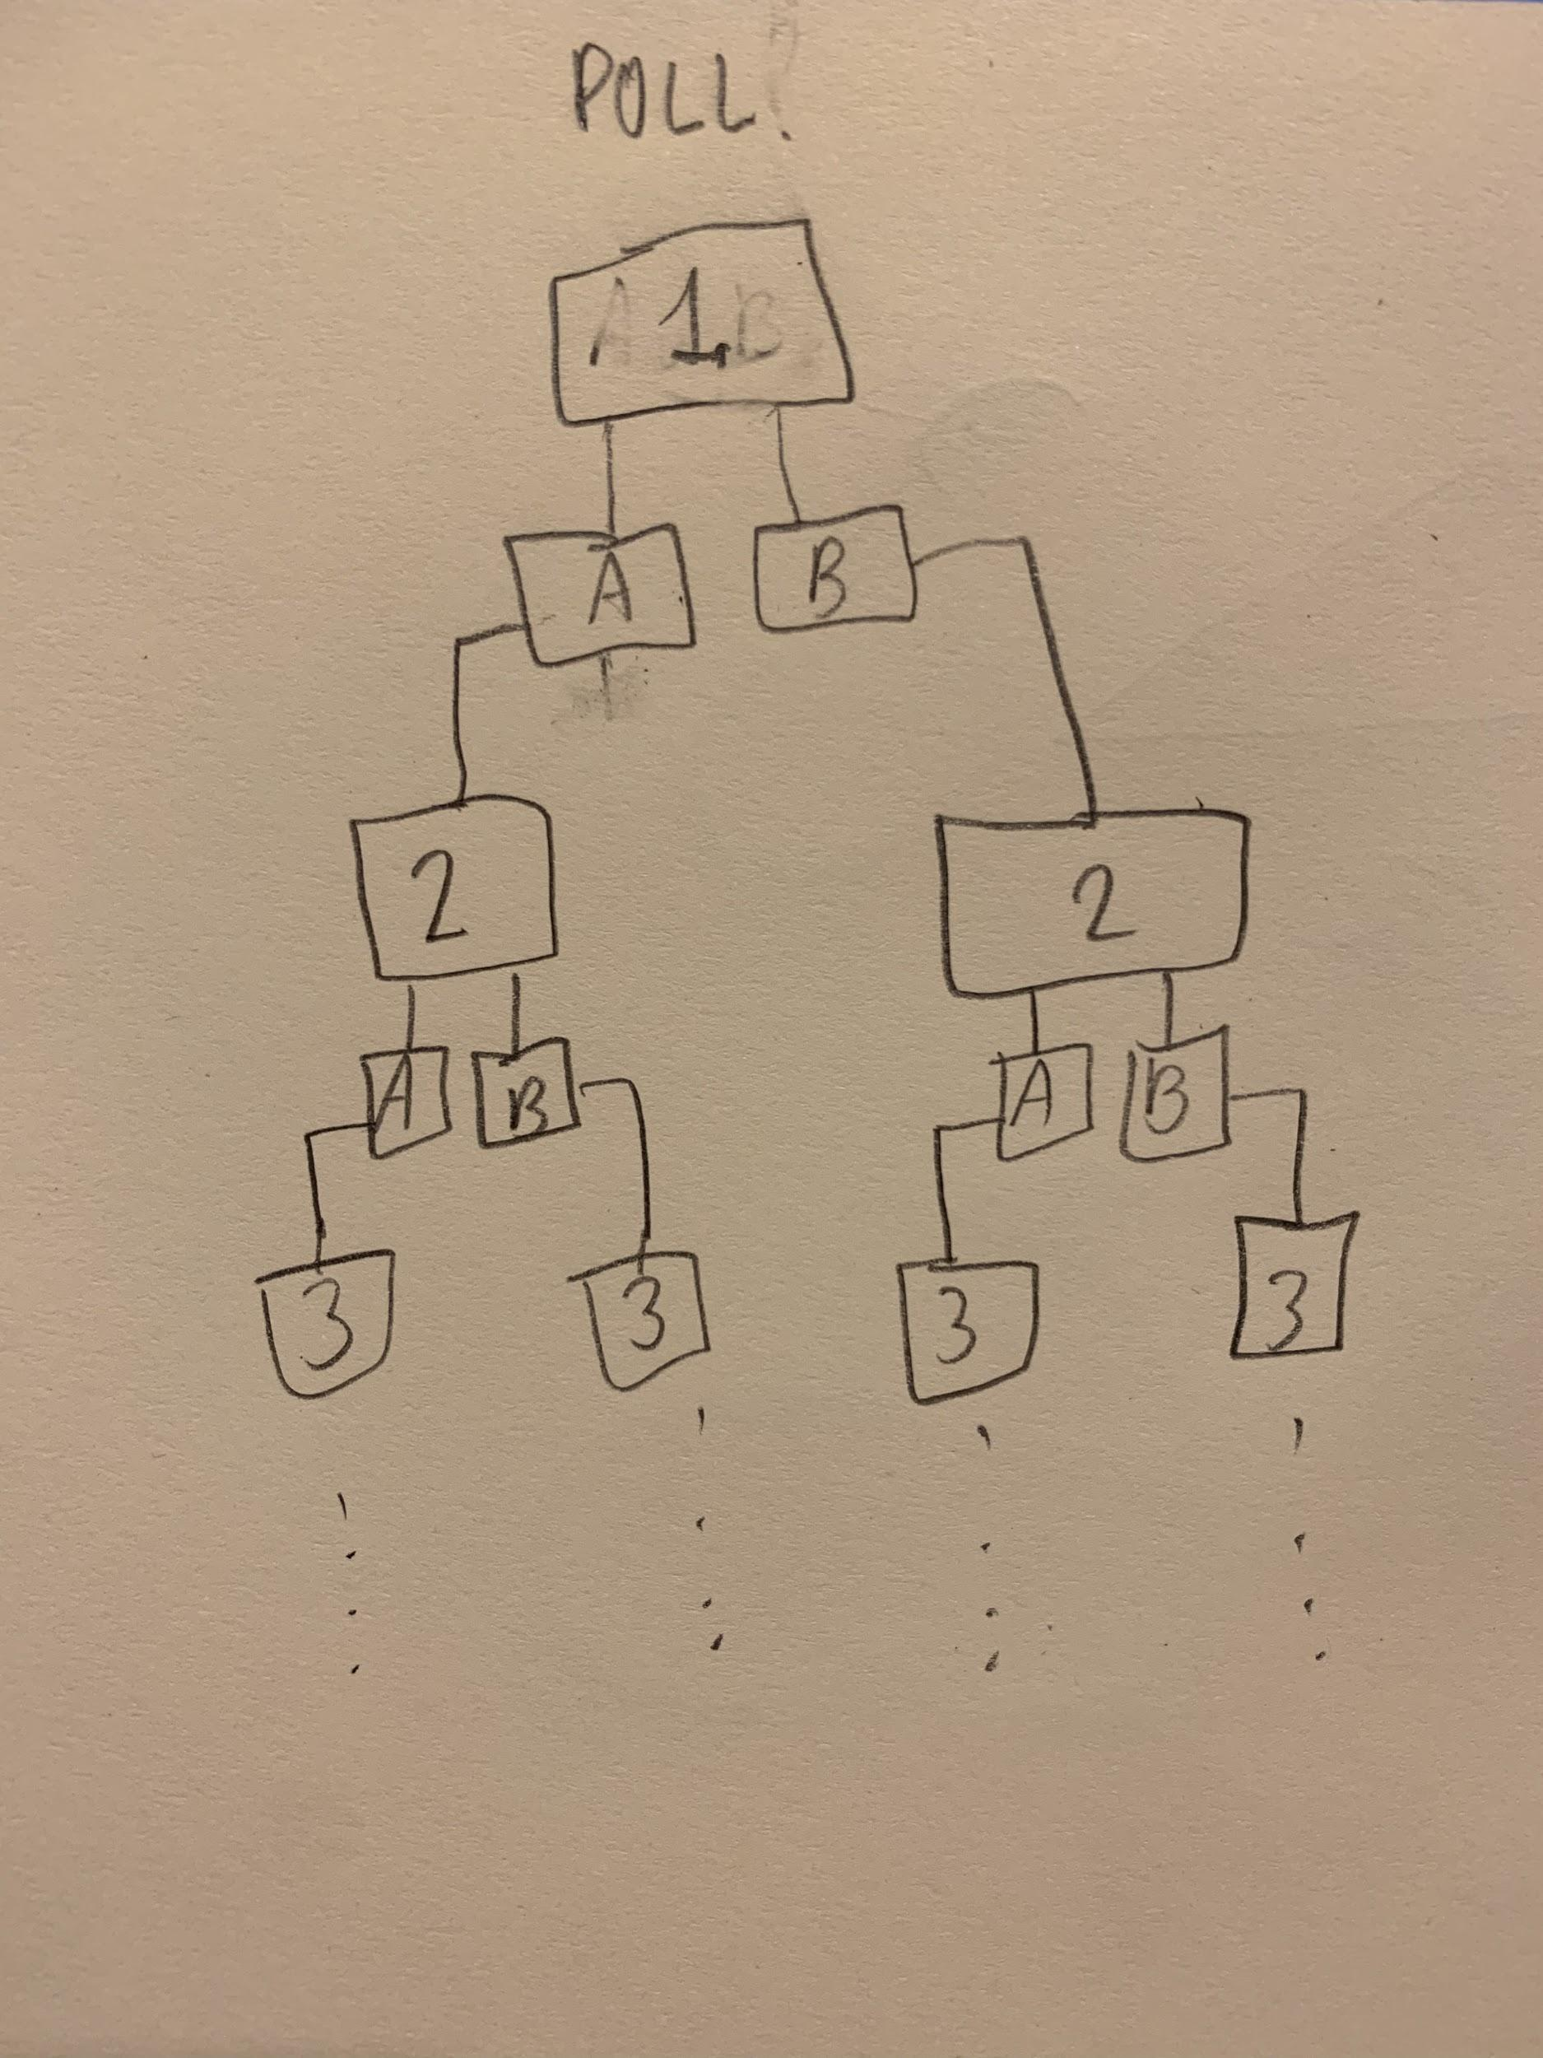
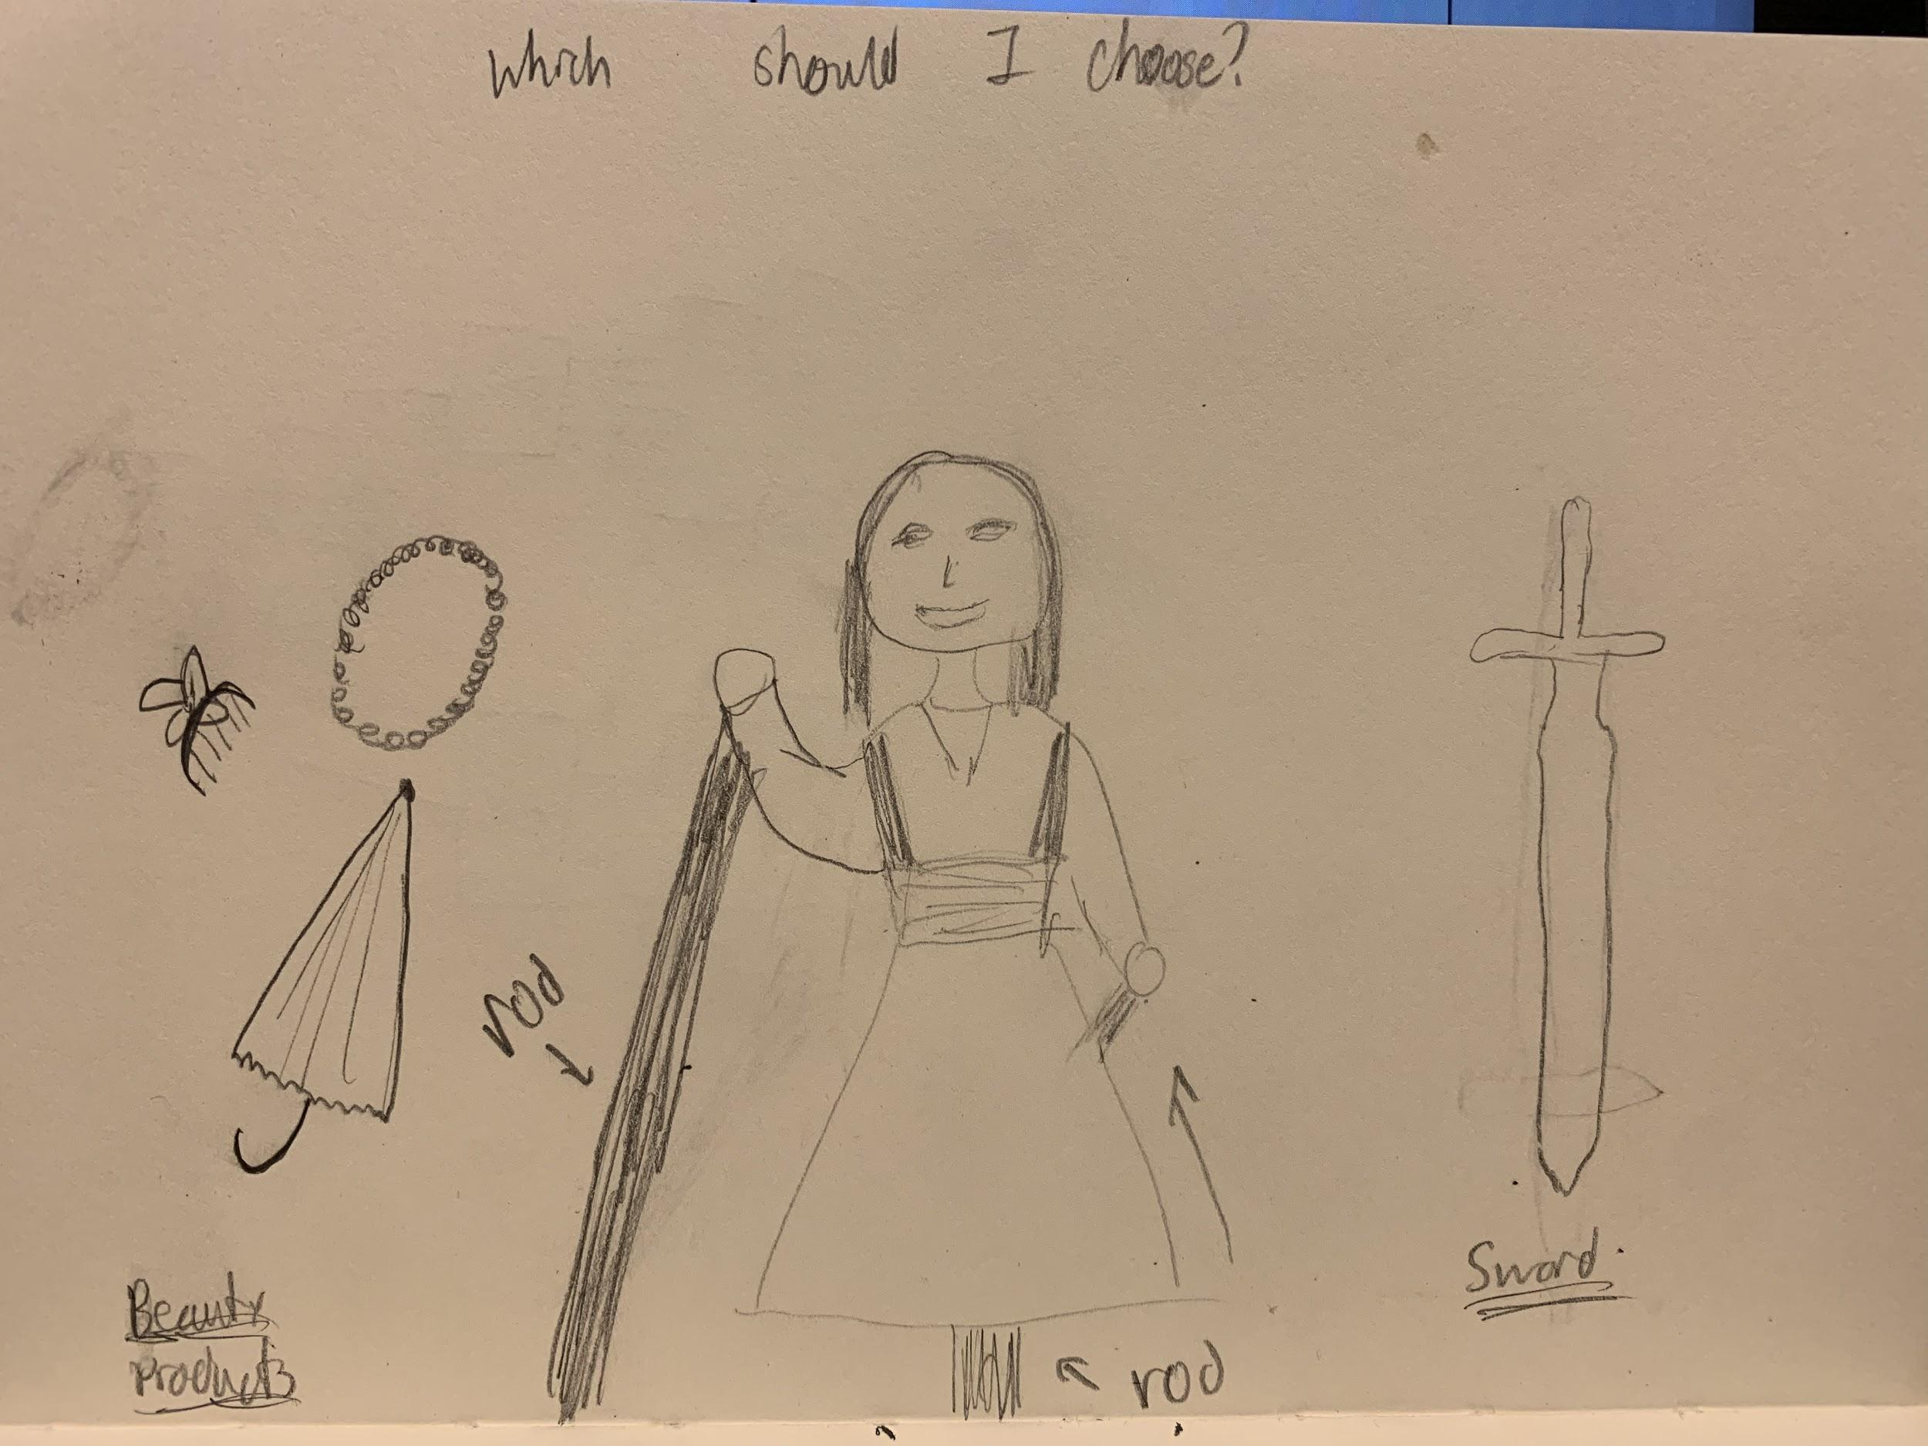

Slide 4
Questions to address
Should there be an end goal? Ending of the story?
Progression of the story
Creating live visuals and interactions

Slide 5
Roles in the project
Aiza & Rachel
Digital
Website
Julie & Keerthi
Maker
Storyboard
Notes:
who does what on the project?
Digital, puppet maker, storywriter, executive producer, final web

